Slide 1




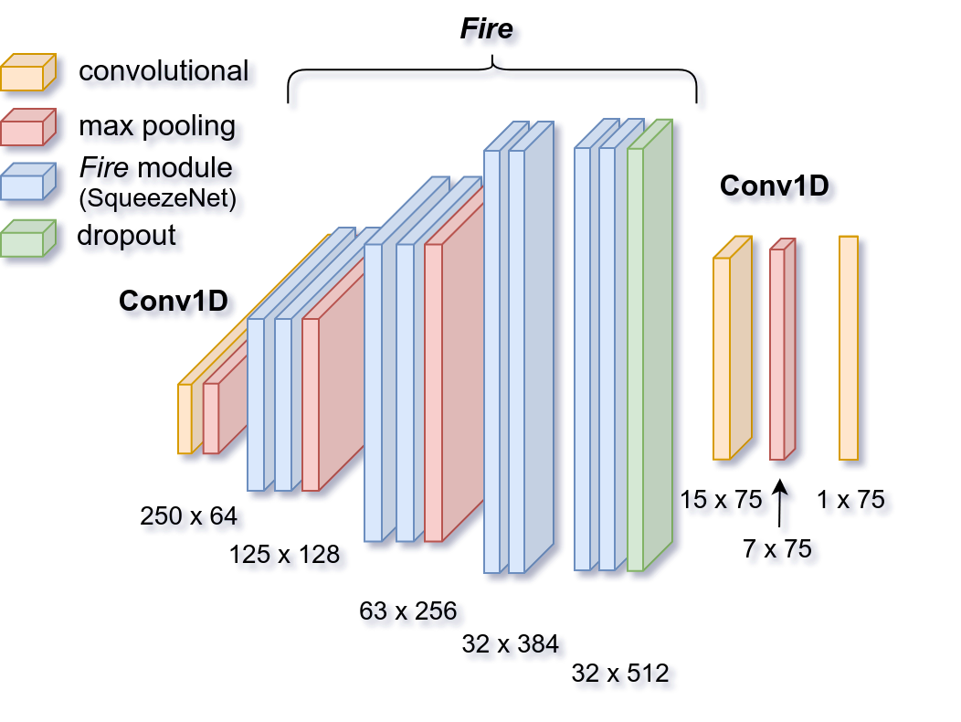
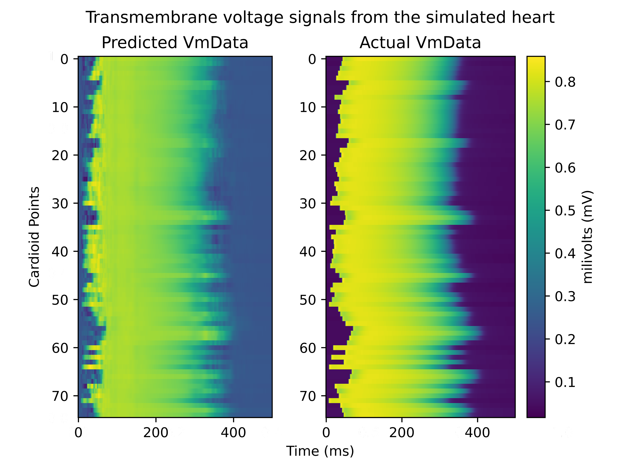
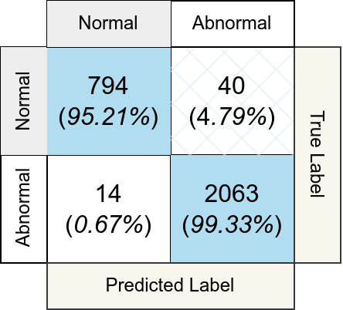
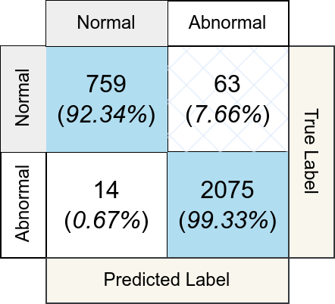
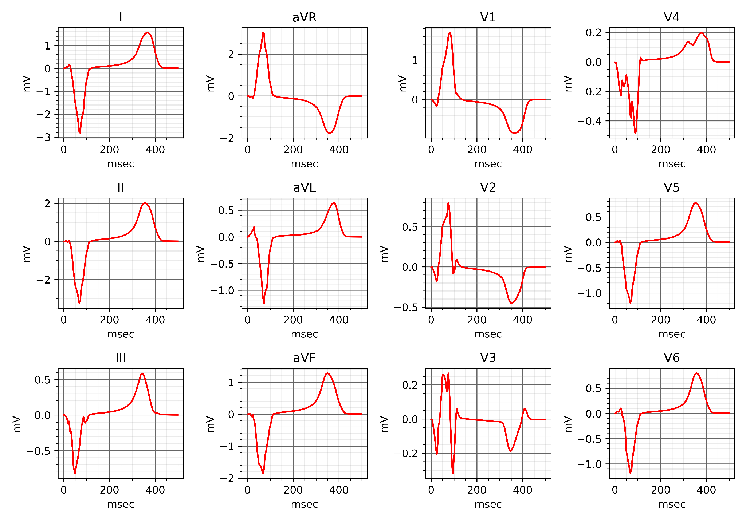
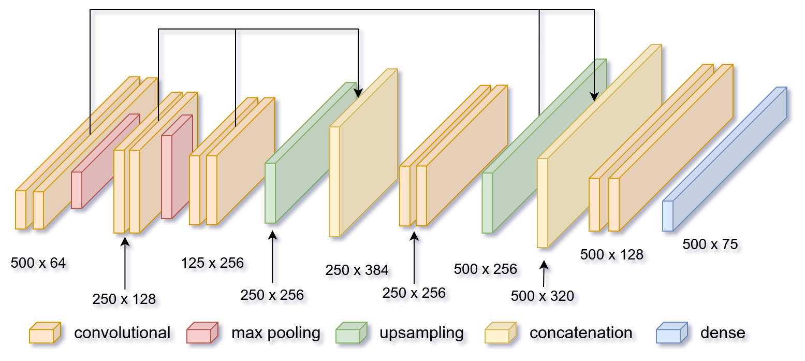
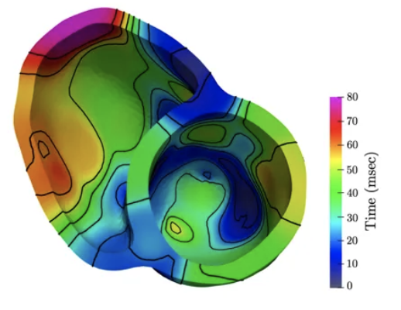
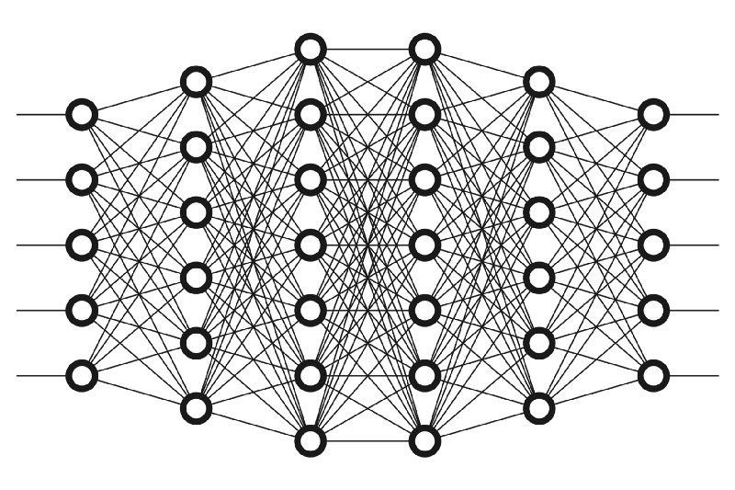
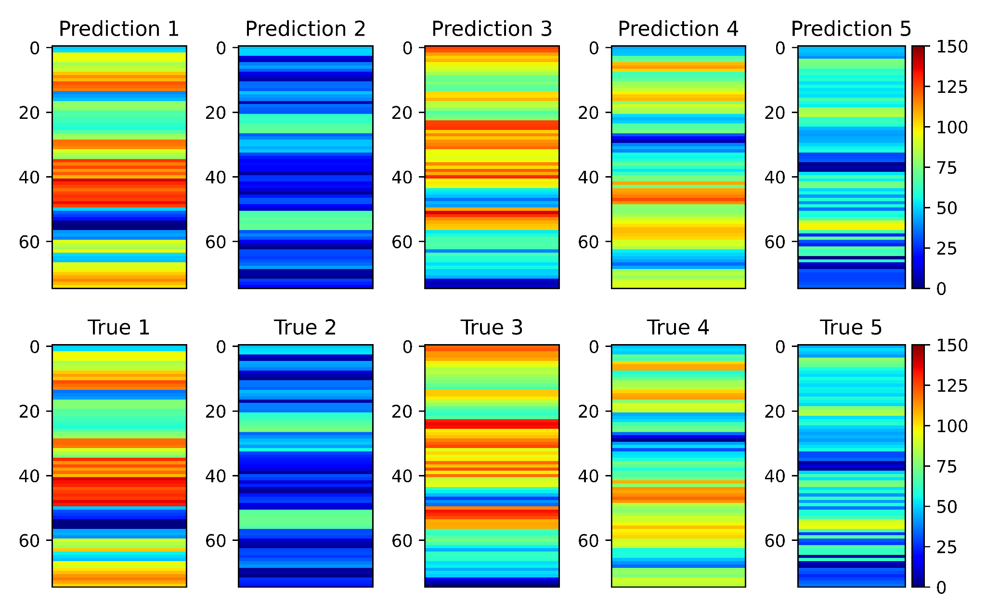
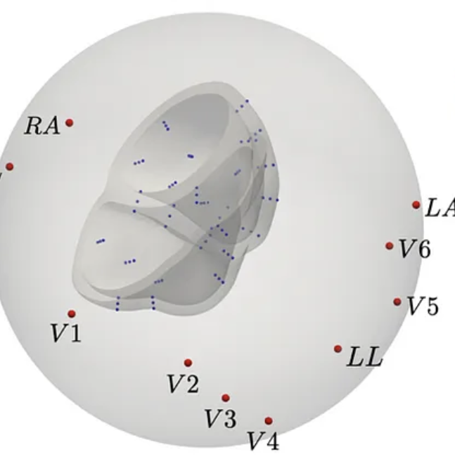
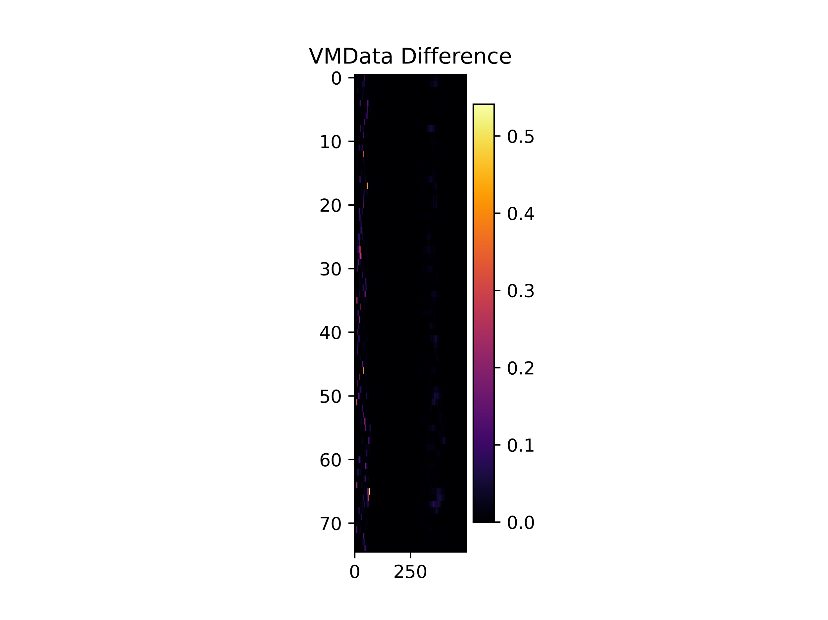
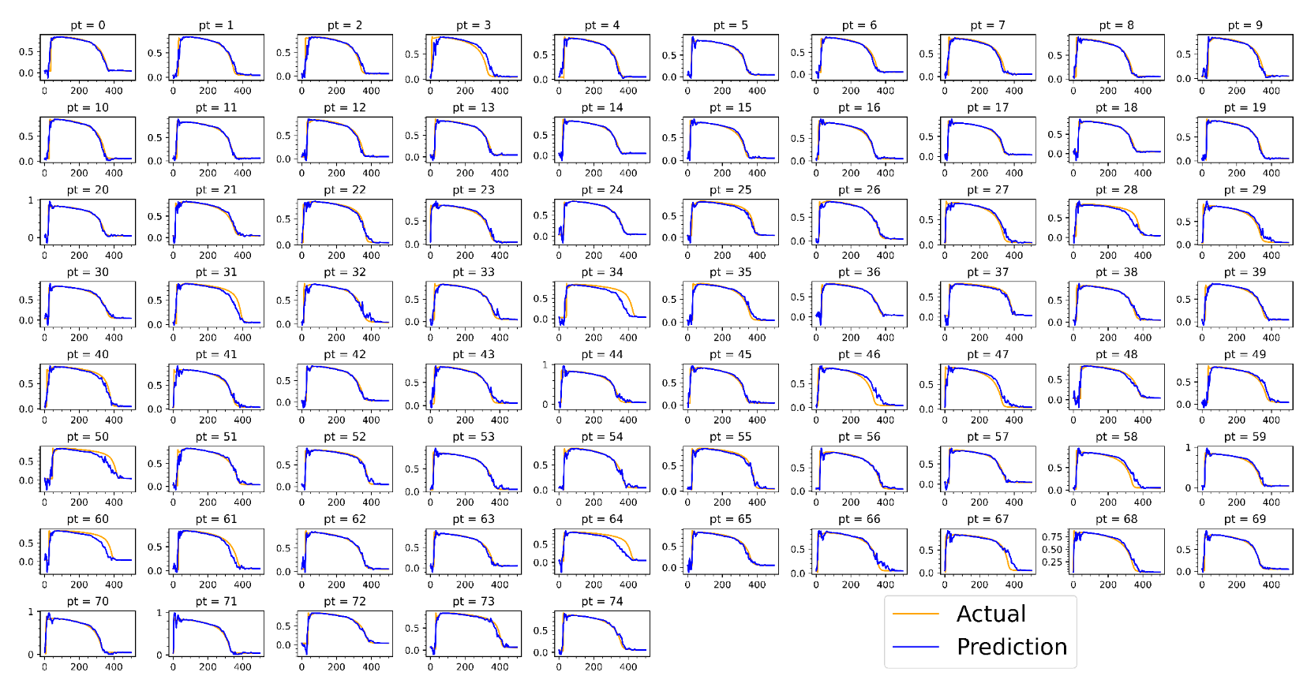
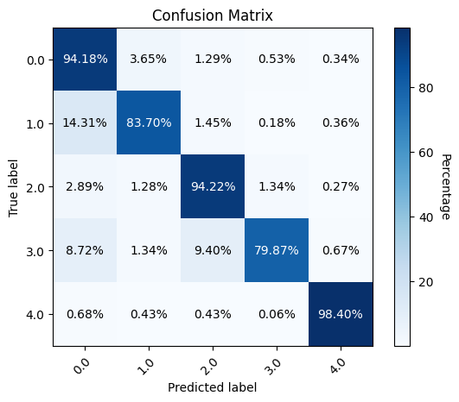
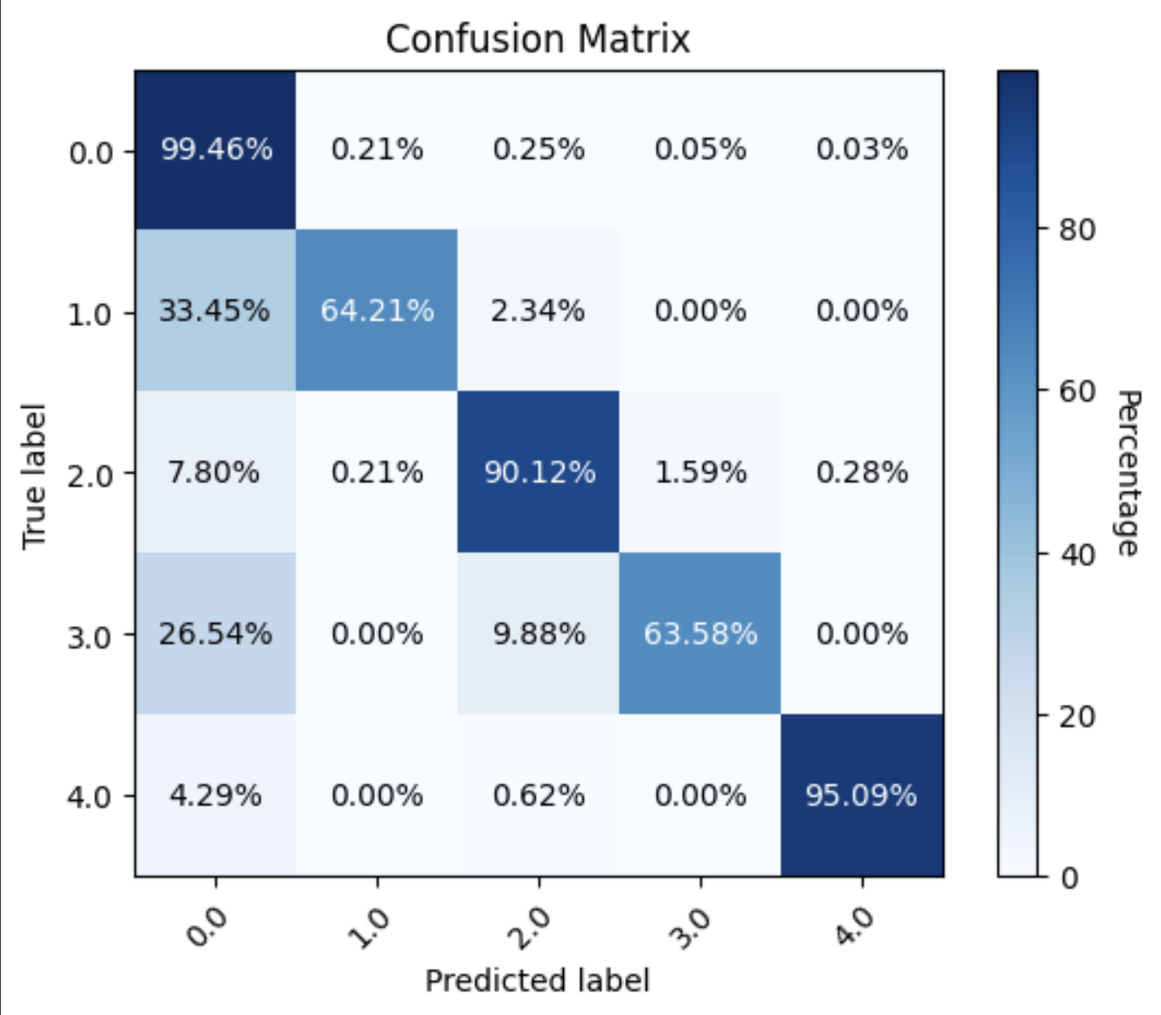
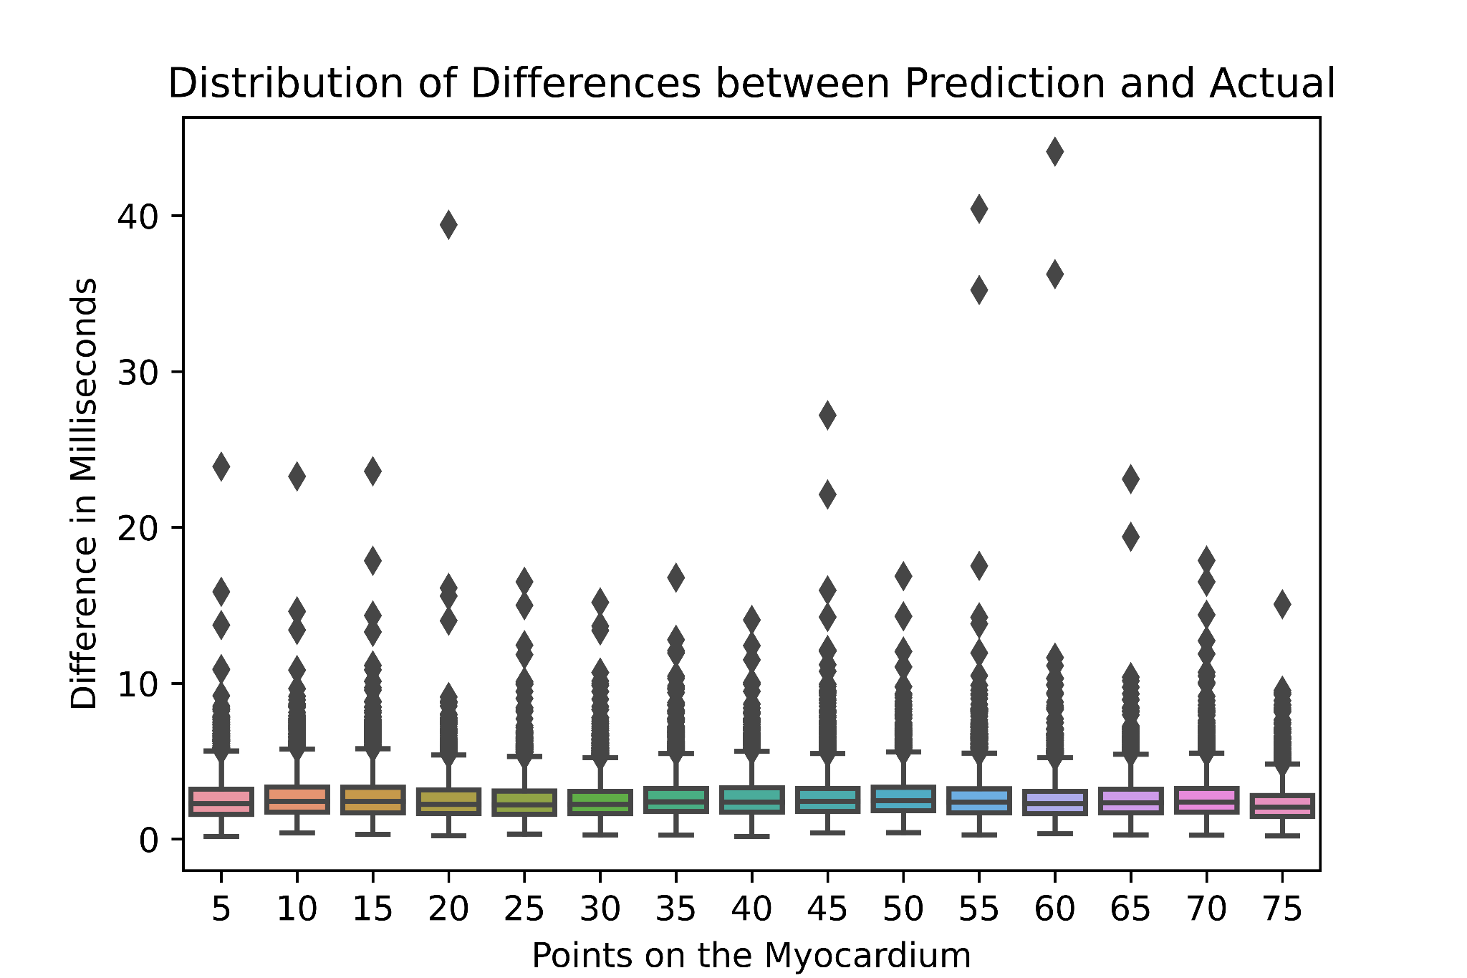
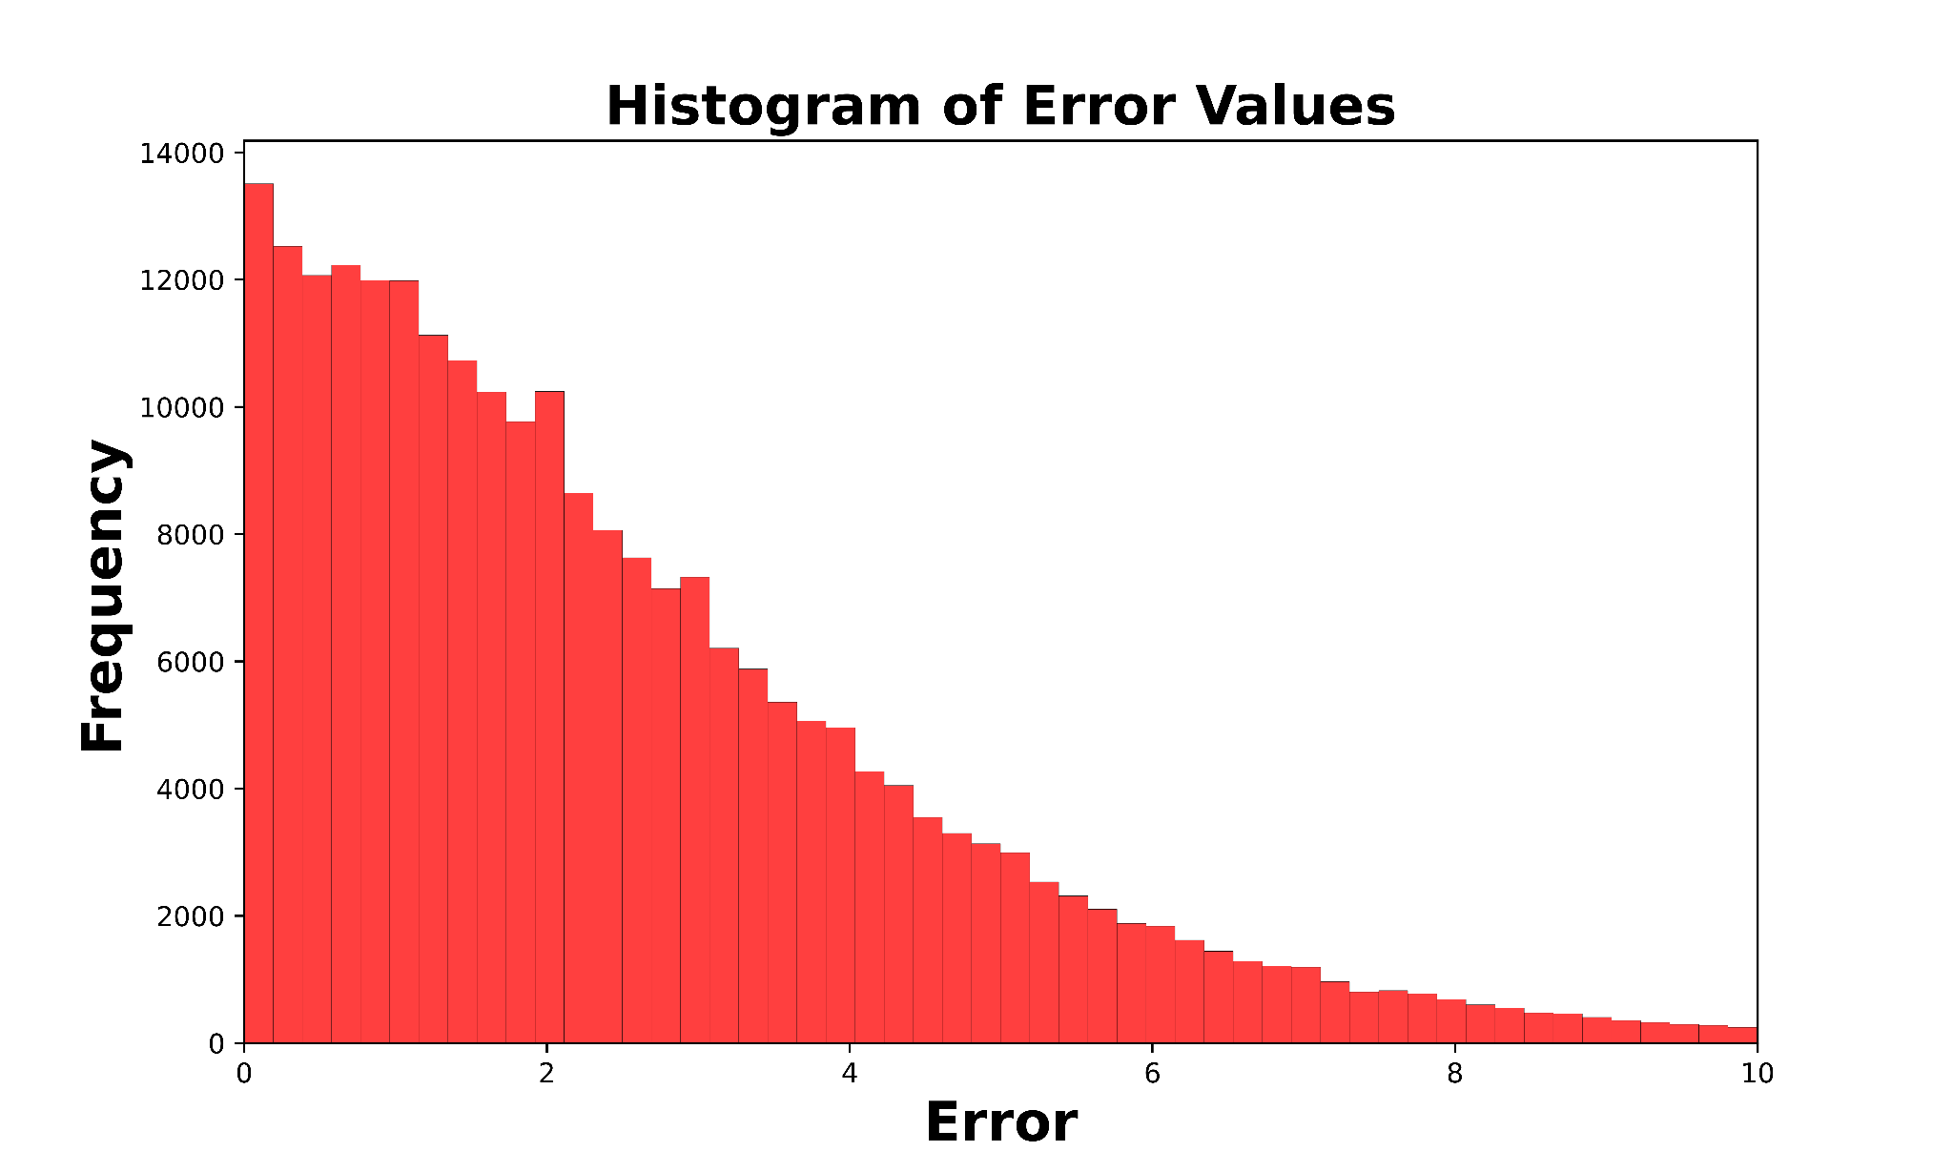
Abstract: In this project, we explored the fascinating realm of cardiac signal analysis through the lens of deep learning techniques. We crafted and fine-tuned convolutional neural networks, integrating skip connections and upsampling for enhanced performance. The study gave us insights into arrhythmia detection, signal patterns, and cardiac anomaly interpretation, revealing the potential of artificial intelligence to revolutionize cardiovascular diagnostics
task3_pics
HeartSpeak: Decoding Signals of the Heart
An exploratory exercise in heart activity prediction and classification
Brandon Pardi², Javier Miranda², Shaan Pakala¹, Zichao Xiao^{1*}, Lorenzo Booth^{2*}
[1] University of California, Riverside [2] University of California, Merced
Remove “abstract” section if not applicable
Abstract: In an exploratory analysis, we examine the performance of various machine learning models applied to the task of modeling heart activity and pathologies. The study gave us insights into arrhythmia detection, signal patterns, and cardiac anomaly interpretation.
Task 3
Task 4
Sequence-to-sequence prediction problem
SqueezeNet (with 1D kernels)
Add additional convolutional layers at the end to reduce the output dimension (1x75)
R square: 0.98
mean error: 2.58 ms
U-net like architecture adapted for 1D convolutions
Skip connections help capture both low AND high level features
Facilitates flow of information from early layers direct to later layers
R² = 0.96, μDiff = 5.27ms
Body text is Arial regular 32 pt.
Use as few words as possible; your figures should tell most of the story
You will be present to fill in a soundtrack
If you don’t have the fonts listed here, please use something similar
Heartbeat Classification: Task 1 & 2
Measures performance
Effectiveness for classifying
Prediction v.s. True Label
TP, FP, FN, TN
Access metrics for evaluation
Precision, Acc., Recall, F1 Score, RT
Abstract: In an exploratory analysis, we examine the performance of various machine learning models applied to the task of modeling heart activity and pathologies.
The abstract should be concise and not use flowery language
Deep Forest
Random Forest
Binary Classification: Normal v.s. Abnormal Heartbeats
Model | Accuracy | Precision | Recall | F1 Score | Training Time
XGBoost | 97.35% | 0.9424 | 0.9715 | 0.9566 | 13 min
Neural Network | 93.20% | 0.8537 | 0.9058 | 0.8789 | 1 min
Random Forest | 97.10% | 0.9203 | 0.9818 | 0.9500 | 40 sec
Deep Forest | 97.25% | 0.9508 | 0.9766 | 0.9635 | 12 min
(Above) An overview of the task: Producing predictions of activation times from ECG time series.
Sample Prediction of Activations for all points in the Myocardium
Task 2
Neural Network
K-Nearest Neighbors
millivolts (mV)
Normal
Normal
Artial Premature
Artial Premature
COLLABORATORS
(.png files with transparent backgrounds)
True Labels
Premature ventricular contraction
Premature ventricular contraction
True Labels
Fusion of ventricular and normal
Fusion of ventricular and normal
Time (ms)
Remove “collaborators” section if not applicable
Fusion of paced and normal
NEXT STEPS
From this exploratory analysis, we propose the following lines of further inquiry:
For Task 2, we would try creating artificial data for the classes with little training data.
For Task 3 and 4, we would try exploring different Neural Network architectures and parameters.
Fusion of paced and normal
Normal
Artial Premature
Premature ventricular contraction
Fusion of ventricular and normal
Fusion of paced and normal
Normal
Artial Premature
Premature ventricular contraction
Fusion of ventricular and normal
Fusion of paced and normal
*optional - One-sentence take-away message/conclusion, centered, bold, 60 pt font
Predicted Labels
Predicted Labels
Remove take-away message/conclusion if not applicable
This work performed under the auspices of the U.S. Department of Energy by Lawrence Livermore National Laboratory under Contract DE-AC52-07NA27344.

Slide 2

Normal
Artial Premature
Premature ventricular contraction
Fusion of ventricular and normal
Fusion of paced and normal
Normal
Artial Premature
Premature ventricular contraction
Fusion of ventricular and normal
Fusion of paced and normal
Neural Network

Slide 3
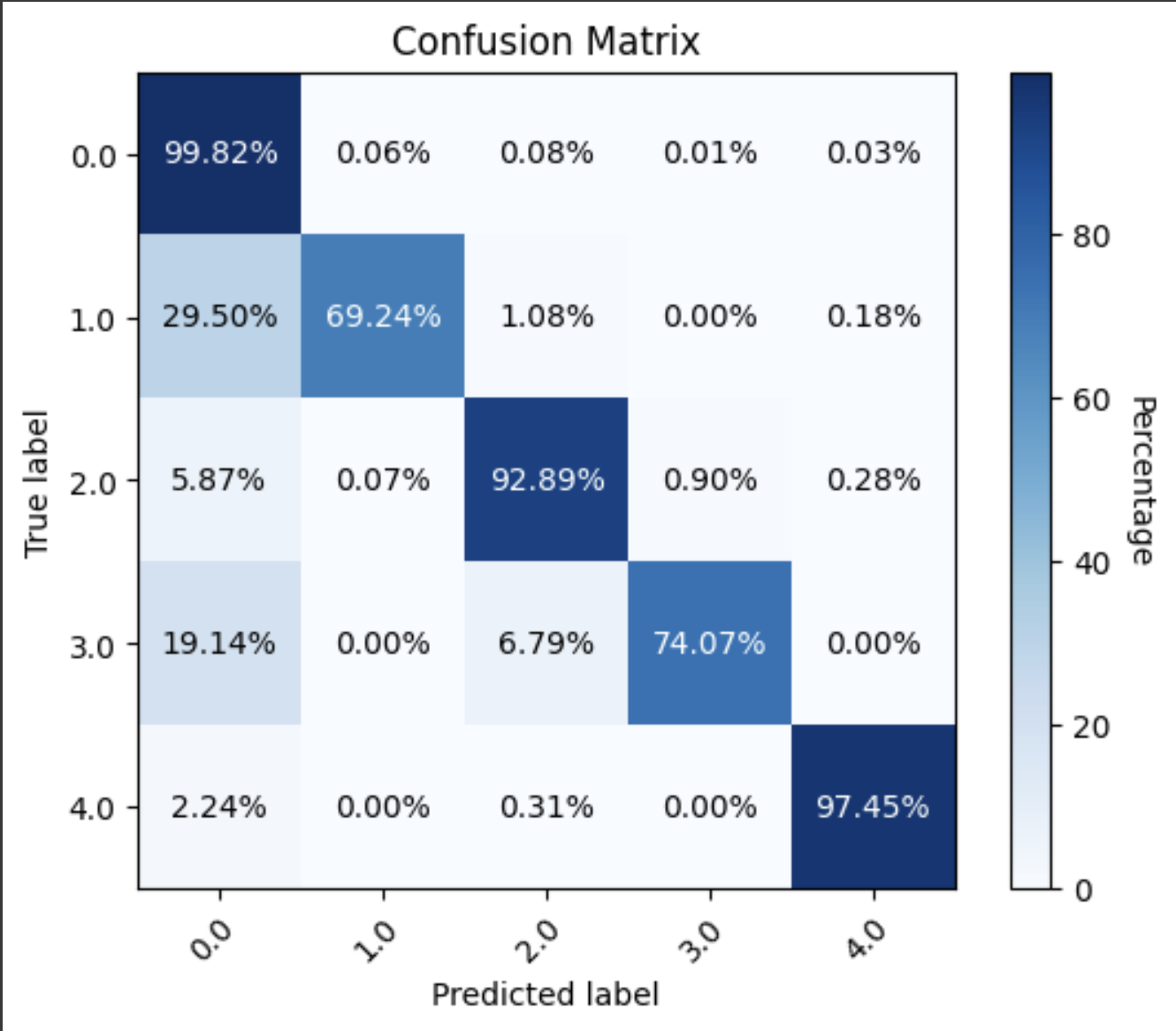
Printing instructions (in-house)
Add IM release number to poster file
Save as PDF
Submit for printing: https://pdmc.llnl.gov/
Step 1 > Posters
Step 2 > Large Posters
Step 3 poster specs
Number of pages = 1
Number of copies = 1
Finished size = 48x36 inches
Platform = select which type of computer you're using
Poster type =
laminated, rollable (if tacking up on a wall or partition)
laminated and mounted (if displaying on an easel)
the following options appear depending on the Poster type selected
Mounting = ½ gator
Laminating = Luster
Frame = none
Poster options = none
Step 4 order details
Due Date
Job title = name of your poster or something like “DSC poster" and your last name
Classification = unclassified
Customer OUN = your OUN
Contact OUN = neily1
Notify for pickup (do not select delivery)
Project number = ask your mentor or the DSC leadership team
Task number = ask your mentor or the DSC leadership team
Comments = required field; can simply enter "poster for summer internship“
Step 5 upload file (must be a PDF)
XGBoost Task 2
K-Nearest Neighbors (Task 2)

Slide 4
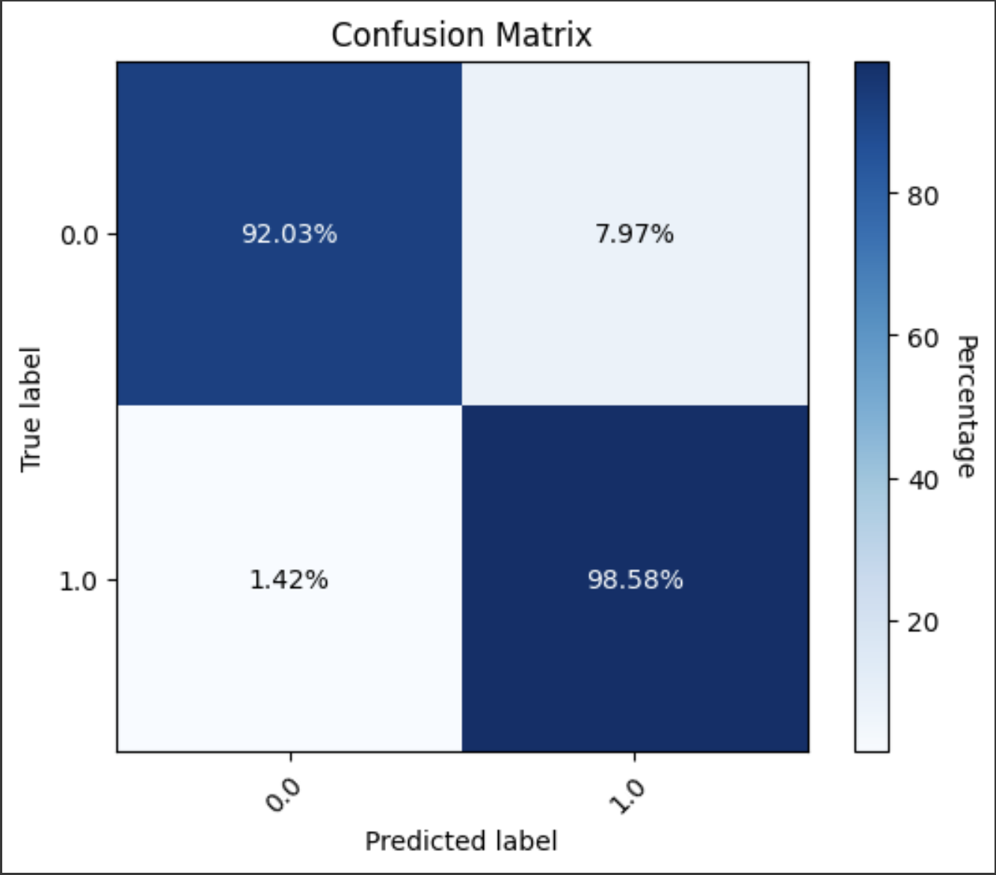
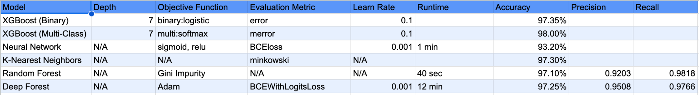
Random Forest Confusion Matrix
True Labels | Normal | (92.03%) | (7.97%)
 | Abnormal | (1.42%) | (98.58%)
Random Forest Confusion Matrix |  | Normal | Abnormal
 |  | Predicted Labels
Multi-Class Classification: Normal vs. Other Heart Diseases (5 Classes)
Model | Accuracy | Precision (Macro Avg.) | Precision (Weighted Avg.) | Recall (Macro Avg.) | Recall (Weighted Avg.) | F1 Score (Macro Avg.) | F1 Score (Weighted Avg.) | Runtime
XGBoost | 98.00% | 0.96 | 0.98 | 0.87 | 0.98 | 0.91 | 0.98 | 21 min
K-Nearest Neighbors | 97.36% | 0.91 | 0.97 | 0.82 | 0.97 | 0.86 | 0.97 | 35 sec
Neural Network | 96.15%
Binary Classification: Normal v.s. Abnormal Heartbeats
Model | Accuracy | Precision | Recall | F1 Score (2 * Precision * Recall) / (Precision + Recall) | Runtime
XGBoost | 97.35% | 0.9424 | 0.9715 | 1.8310/1.9139 0.9566 | 13 min
Neural Network | 93.20% | 0.8537 | 0.9058 | 1.5465/1.7595 0.8789 | 1 min
Random Forest | 97.10% | 0.9203 | 0.9818 | 1.8071/1.9021 0.9500 | 40 sec
Deep Forest | 97.25% | 0.9508 | 0.9766 | 1.8571/1.9274 0.9635 | 12 min

Slide 5
SqueezeNet – A CNN Architecture with fewer parameter has several advantages:
More efficient distributed training
Less overhead when exporting new models to clients
Feasible FPGA and embedded deployment

